Slide 1
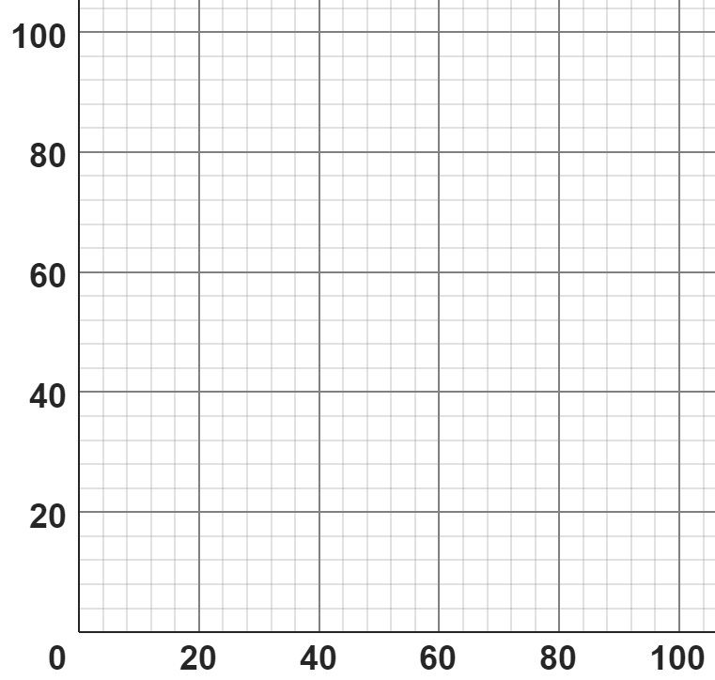
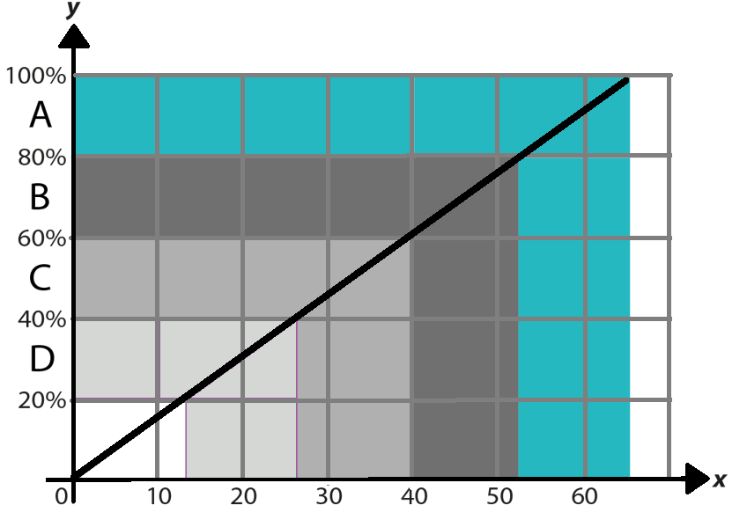
Multiplicative relationships presented graphically
Task A: Percentages of amounts graphically
1) Match the double number line with the corresponding graph.
%
%
%
£
£
£
0%
80%
0%
100%
0%
80%
£0
£100
£0
£80
£0
£50
2) A class of students took a test. The grades available were A, B, C or D.
The graph helps the teacher convert a score out of 65 to a grade.
Jun scored 35 marks on his assessment.
a) What grade did Jun get?
b) Estimate his percentage score.
c) Estimate the minimum mark you need to get a grade. What calculation could you carry out to be more accurate?
Mark

Slide 2
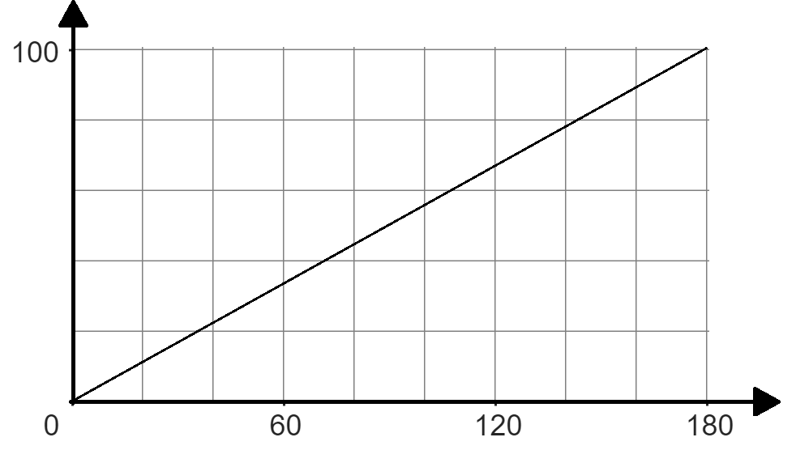
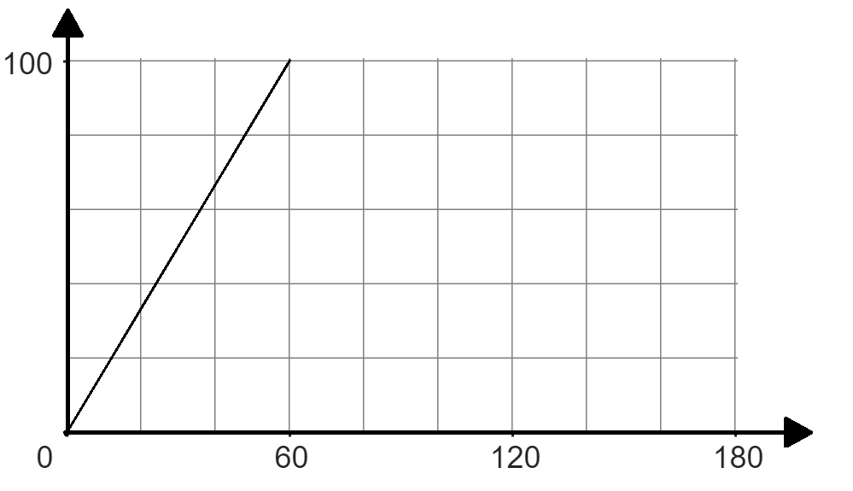
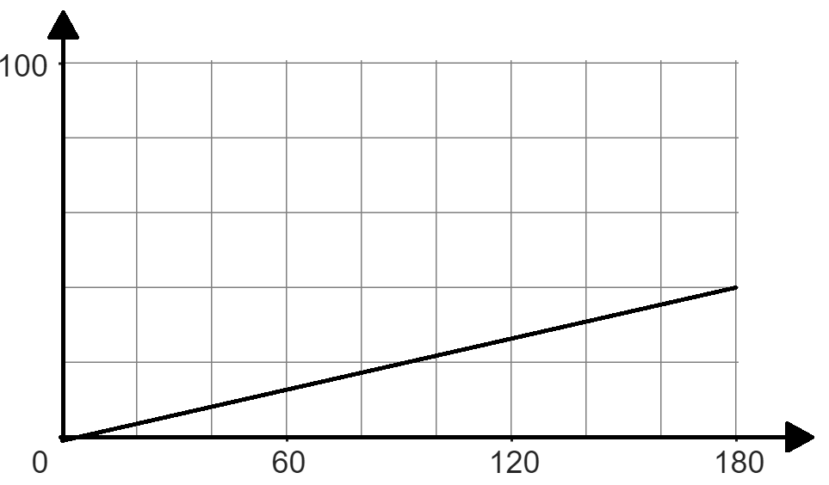
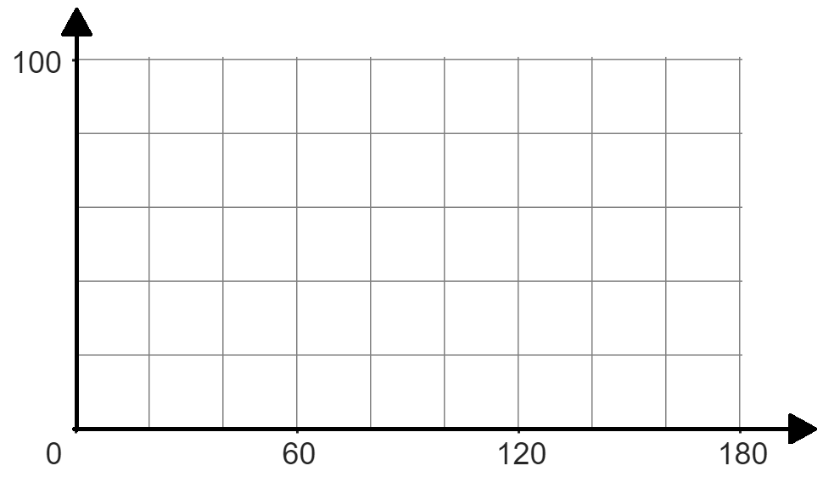
Multiplicative relationships presented graphically
3a) Fill in the missing information given the graph and double number line.
%
%
£
£
£
40
100
20
100
%
%
£
60
£
72
180
12
3b) Fill in the missing information given the graph and double number line.
%
%
£
£
.
40
100
33.3
100%
%
%
180
450
£
240
£
80
2

Slide 3
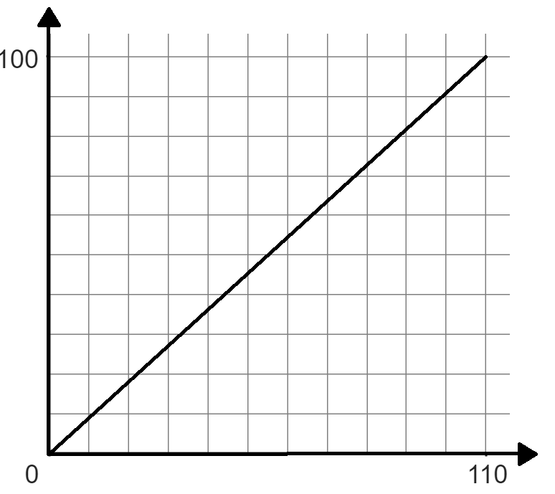
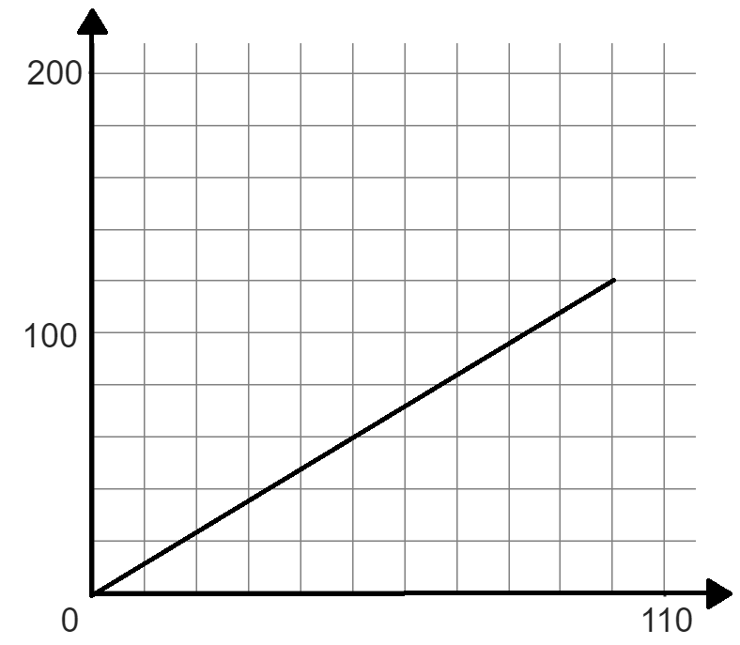
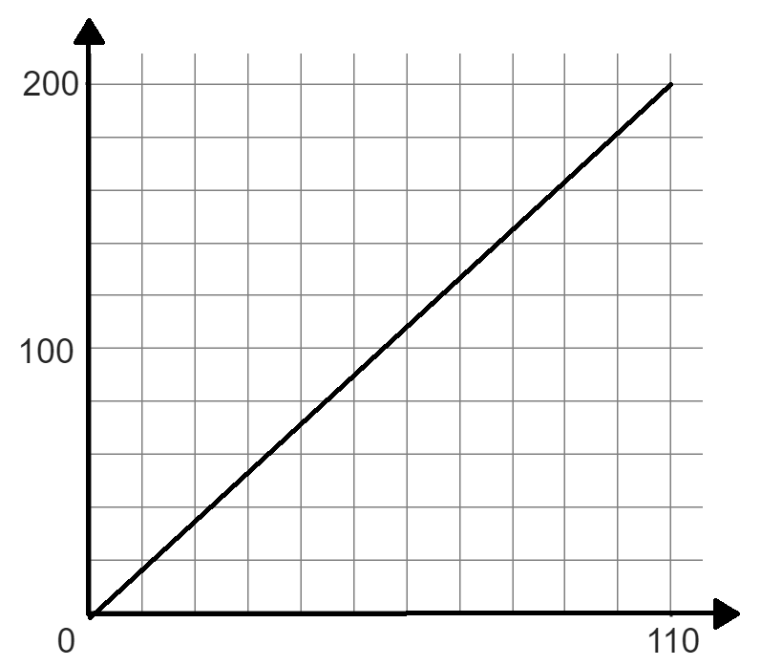
Multiplicative relationships presented graphically
Task B: Other representations of proportional relationships
1) Write what you think are the advantages and disadvantages of using a graph, double number line and ratio table when trying to find a percentage of an amount.
 | Graph | Double number line | Ratio table
Advantages
Disadvantages
2) Match the ratio table with the correct graph and work out the missing amount using the ratio table.
Amount | %
110 | 100
 | 55
Amount | %
55 | 100
 | 55
Amount | %
100 | 120
 | 36
%
%
%
A
A
A
Mathematics in Education and Industry.
v2.3

